Slide 1

Reductions and Decomposition
Software engineering as one facet of problem decomposition; complexity theory and reductions as another facet.
Kevin Lin, with thanks to many others.
Notes:
Ask questions anonymously on Piazza. Look for the pinned Lecture Questions thread.

Slide 2
Feedback from the Reading Quiz
Reduction. Using an algorithm for Problem Q to solve Problem P.
P ≤ Q in terms of difficulty since we can use the algorithm for Q.
Informally*…
2-d nearest neighbor search (NNS) problem. Given an (x, y) pair, find the nearest point.
NNS “reduces” to linear search, so NNS ≤ linear search in terms of difficulty.
But we can improve algorithm efficiency.
KdTreePointSet. Randomized k-d tree is logarithmic height.
* Confusing algorithms and their problems, not actually a “reduction.”
How to solve hard problems we have not seen before?

Slide 3
Arbitrary Challenging Problem of the Day
Suppose we have a 2 dimensional space from 0 to MAX_X and 0 to MAX_Y.
e.g. MAX_X = 100, MAX_Y = 100.
100
100

Slide 4
Arbitrary Challenging Problem of the Day
(20, 90)
(40, 60)
Find all labels that overlap the query.
findAnswer(20, 90, 40, 60)
[“AA”, “AB”, “BA”, “BB”]
100
AA | AB | AC | AD
BA | BB | BC | BD
CA | CB | CC | CD
DA | DB | DC | DD
100

Slide 5
Goal: Fill in the findAnswer Method
public class Rasterer {
private static final double MAX_X = 100;
private static final double MAX_Y = 100;
public static List<String> findAnswer(double x1, double y1,
double x2, double y2) {
// TODO
return null;
}
}
What are some potentially useful helper methods?

Slide 6
Arbitrary Challenging Problem of the Day
Q
(20, 90)
(40, 60)
Find all labels that overlap the query.
findAnswer(20, 90, 40, 60)
[“AA”, “AB”, “BA”, “BB”]
100
AA | AB | AC | AD
BA | BB | BC | BD
CA | CB | CC | CD
DA | DB | DC | DD
100

Slide 7
findAnswer Problem Decompositions
Decomposition. Taking a complex task and breaking it into smaller parts. This is the heart of computer science. Using appropriate abstractions makes problem solving vastly easier.
Solve for the x-axis problem alone. Solve for the y-axis problem alone.
Hash table-like representation mapping (0, 100) -> “AA”

Slide 8
Problem Decomposition in Software Engineering
Decomposition. Taking a complex task and breaking it into smaller parts. This is the heart of computer science. Using appropriate abstractions makes problem solving vastly easier.
Perspective 1: Software engineering.
Eliminating special cases in k-d tree nearest made code simpler and more obvious.
Modularization is decomposition for managing software complexity at a project level.
Autocomplete. Efficient search bar prefix queries.
Heap. Efficient priority queue for route finding.
K-d Tree. Efficient 2-d nearest neighbors to find start and goal vertices.
A* Search. Efficient route finding.
Rasterer. Efficient map tile display.

Slide 9
Problem Decomposition in CS Theory
Decomposition. Taking a complex task and breaking it into smaller parts. This is the heart of computer science. Using appropriate abstractions makes problem solving vastly easier.
Perspective 2: Computational complexity theory.
Reduction. Using an algorithm for Problem Q to solve Problem P.
“If any subroutine for task Q can be used to solve P, we say P reduces to Q.”
Algorithms (Dasgupta, Papadimitriou, Vazirani)

Slide 10
Graph Problems and Their Solutions
Paths. Find a path from s to every reachable vertex. Depth-first search. O(V + E) runtime with adjacency list.
Unweighted Single-Source Shortest Paths. Find a shortest path from s to every reachable vertex. Breadth-first search. O(V + E) runtime with adjacency list.
Weighted Single-Source Shortest Paths. Find a shortest path from s to every reachable vertex. Dijkstra’s algorithm. O(E log V + V log V) runtime with adjacency list.
Weighted Single-Pair Shortest Paths. Find a shortest path from s to a single goal vertex. A* search. Dijkstra’s algorithm with h(v, goal) as priority. Runtime depends on heuristic.

Slide 11
Algorithm for Finding a Shortest Paths Tree
Q
Given a weighted, directed graph with integer edge weights between 1 and 5, find the single-source shortest paths tree from s to every other vertex in the graph.
Your algorithm should be faster than Dijkstra’s algorithm.
2
B
5
2
0
4
s
A
1
D
1
1
5
C

Slide 12
Dijkstra’s Runtime Analysis
PQ.add(s, 0)
For all other vertices v, PQ.add(v, infinity)
While PQ is not empty:
p = PQ.removeSmallest() Relax all edges from p
Relaxing an edge (v, w) with weight:
If distTo[w] > distTo[v] + weight:
distTo[w] = distTo[v] + weight edgeTo[w] = v PQ.changePriority(w, distTo[w])
ArrayHeapMinPQ implementation.
V adds, each O(log V) time.
V removals, each O(log V) time.
E changePriority, each O(log V) time.
Overall: O(V log V + V log V + E log V).
Simple: O(V log V + E log V).
Assuming E > V, this is just O(E log V) for connected graphs.

Slide 13
Optimized Priority Queue
Fringe
A
A
0
1
2
3
4
5
A
D
Implement priority queue with constant time operations for Dijkstra’s algorithm.
When we visit v, each neighbor must be one of either:
distTo[v] + 1.
distTo[v] + 2.
distTo[v] + 3.
distTo[v] + 4.
distTo[v] + 5.
C
C
B
B
D
D
B
2
B
B
5
2
0
4
s
A
1
A
D
D
1
1
5
C
C

Slide 14
Reduction to BFS
A
B
For every edge e with weight w, replace e with a chain of w - 1 dummy vertices.
Then, run BFS on the result.
Return the shortest paths to real vertices.
s
A
D
C
2
B
5
2
0
4
s
A
1
D
1
1
5
C

Slide 15
Reductions
Given a graph G, we created a new graph G’, then fed it to a related (but different) algorithm, and finally interpreted the result.
G
G’
B
B
5
2
A
1
D
Preprocess
A
D
1
5
C
C
BFS
BreadthFirstPaths
SPT(G, A)
Postprocess

Slide 16
Topological Ordering

Slide 17
Topological Ordering
Q
2
0
3
5
1
4
6
7
Suppose we have tasks 0 through 7, where an arrow from v to w indicates that v must happen before w.
Which graph algorithm could we use to find a valid ordering for these tasks?
Valid orderings include: [0, 2, 1, 3, 5, 4, 7, 6], [2, 0, 3, 5, 1, 4, 6, 7], …

Slide 18
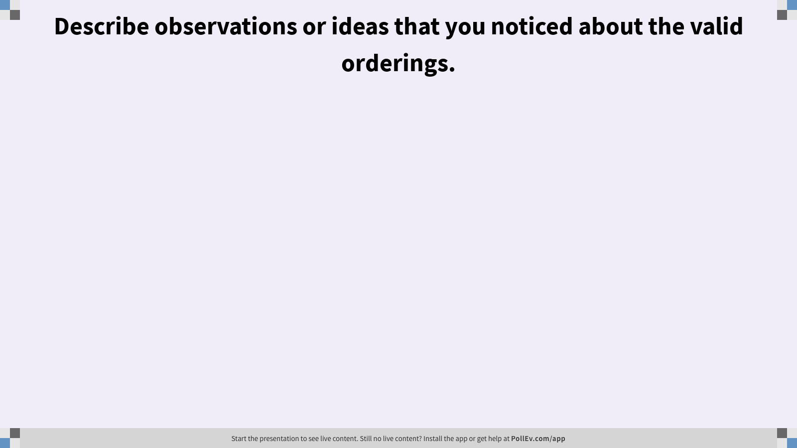
Describe observations or ideas that you noticed about the valid orderings.

Slide 19
2
2
2
2
*
0
3
5
0
3
5
0
3
5
0
3
5
*
*
1
4
6
1
4
6
1
4
6
1
4
6
*
7
7
7
7
Postorder: []
Postorder: []
Postorder: []
Postorder: [7]
2
2
2
2
*
*
0
3
5
0
3
5
0
3
5
0
3
5
*
*
1
4
6
4
6
4
6
1
4
6
1
1
7
7
7
7
Postorder: [7, 4]
Postorder: [7, 4, 1]
Postorder: [7, 4, 1]
Postorder: [7, 4, 1, 3]

Slide 20
2
2
*
2
2
*
*
*
0
3
5
0
3
5
0
3
5
0
3
5
4
6
4
6
4
6
1
4
6
1
1
1
7
7
7
7
Postorder: [7, 4, 1, 3]
Postorder: [7, 4, 1, 3, 0]
Postorder: [7, 4, 1, 3, 0]
Postorder: [7, 4, 1, 3, 0]
2
2
2
*
0
3
5
0
3
5
*
0
3
5
4
6
*
1
4
6
4
6
1
1
7
7
7
Postorder: [7, 4, 1, 3, 0, 6]
Postorder: [7, 4, 1, 3, 0, 6, 5]
Postorder: [7, 4, 1, 3, 0, 6, 5, 2]

Slide 21
Topological Ordering
A
2
0
3
5
1
4
6
7
Perform a DFS traversal from every vertex with indegree 0, remembering marked vertices in between traversals. Record DFS postorder in a list.
Topological ordering is given by the reverse of that list (reverse postorder).
Postorder: [7, 4, 1, 3, 0, 6, 5, 2]
Reversed: [2, 5, 6, 0, 3, 1, 4, 7]

Slide 22
Topological “Sorting”
0
3
2
5
1
6
4
7
2
5
6
0
3
1
4
7

Slide 23
Seam Carving

Slide 24


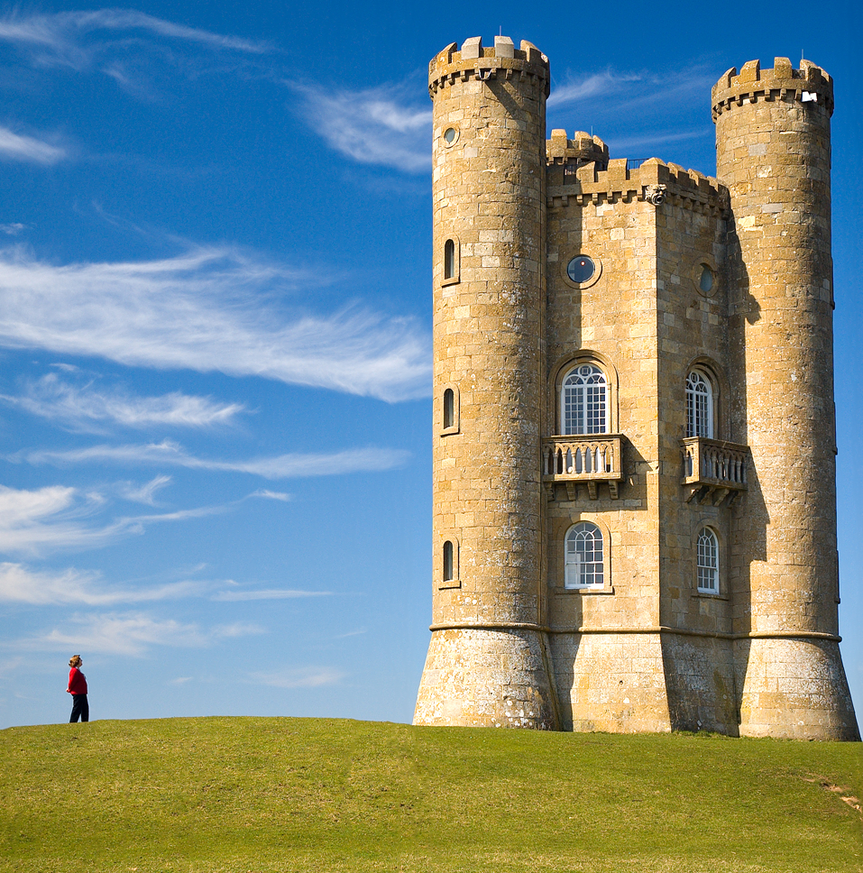
Content-Aware Image Resizing
Seam carving. Resize an image without distortion for display on phones and internet.
Original Photo
Horizontally-Scaled
Seam-Carved
Seam carving for content-aware image resizing (Avidan, Shamir/ACM); Broadway Tower (Newton2, Yummifruitbat/Wikimedia)

Slide 25


Slide 26
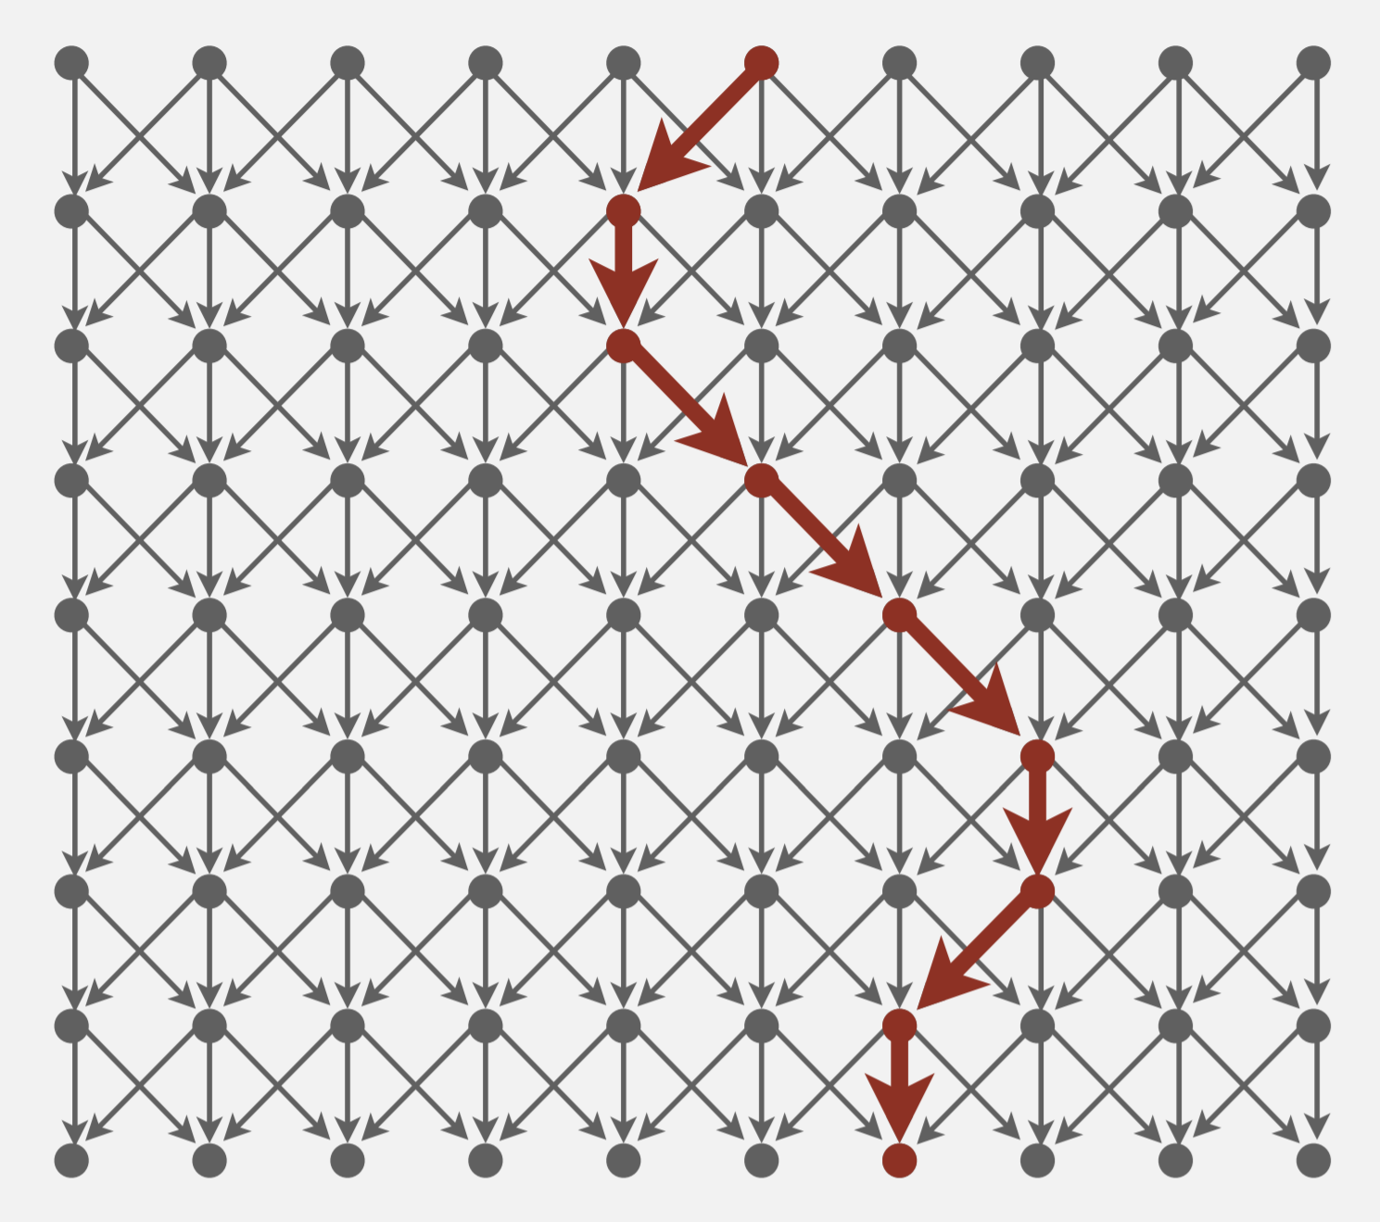
Reduction to Dijkstra’s
To find a vertical seam…
Vertex. Pixel in image.
Edge. Cost to go from a pixel to its 3 downward neighbors.
Weight. Energy function of 8 neighboring pixels.
Seam. Shortest path (sum of weights) from top to bottom.
Shortest Paths (Robert Sedgewick, Kevin Wayne/Princeton)

Slide 27
Formal Problem Statement
Q
Using AStarSolver, find the seam from any top vertex to any bottom vertex.
Given a digraph with positive edge weights, and two distinguished subsets of vertices S and T, find a shortest path from any vertex in S to any vertex in T.
Your algorithm should run in time proportional to E log V in the worst case.
S
T
Shortest Paths (Robert Sedgewick, Kevin Wayne/Princeton)

Slide 28

What is your burning question from today’s lecture?

